Slide 1






Key Partners
Key Activities
Value Propositions
Buy-in & Support
Beneficiaries
Acting as a broker between the company and autism in hiring people to work.
Acting as a consultant, analyst, and problem solvers.
Users can follow our social media for more information
There is an AI chatbot that will be supporting autistic people for a minor problem.
Autistic people that is looking for work
Autistic children who find a dream and passion.
Autistic children who have problems with learning
Autistic Thai Foundation
Autistic child school
Companies that cooperate with Autistic Thai Foundation
Increase your chances of getting accept into work
After complete the exam ,you will get the certificate that says you are able to work.
Key Resources
Deployment
Facebook page
Facebook group
Email
Phone number
Web page
Instagram
Azure Services
Visual Studio Codespaces
Azure Bot Service
Data center costs
Machine Learning Studio
App service
Mission Budget/Cost
Mission Achievement/Impact Factors
Azure costs
Visual Studio Codespaces
Azure Bot Service
Data center costs
Machine Learning Studio
App service
We will collect the percentage gain from the contract between autistic people and the company based on the salary on the first-year income.
Your Team Name Goes Here: AI-shiteru
Be part of making a difference in 2020

Slide 2


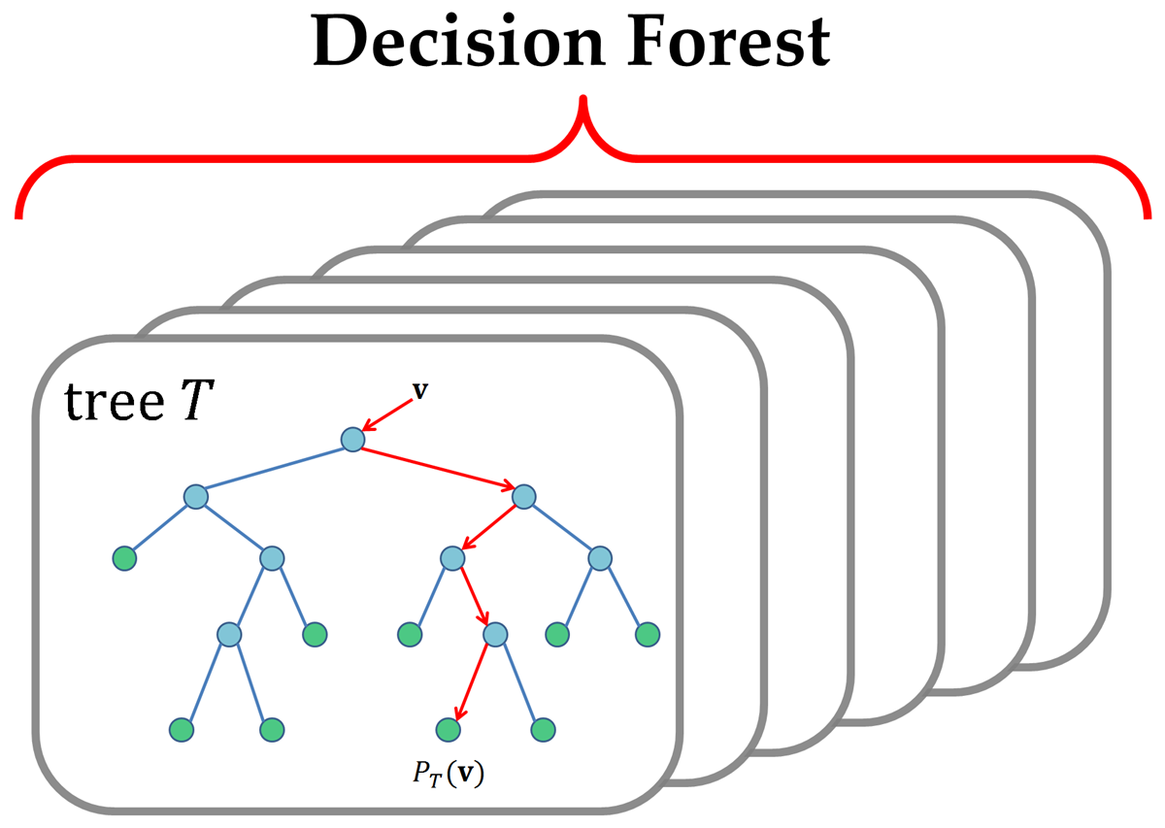


Recommend System
Online Course
Virtual Workshop
Certification Test
We will find an interesting career through the data collected by the recommended system using Multiclass Decision Forest in Azure's Machine ​ Learning.
Learn the theory from experts from the basics to be able to practice in a virtual workshop, which if the learner likes it, can continue to study in the next course but if the learner doesn't like he can change the course with the ability to choose whether to let AI decide or whether to decide for yourself.
Experimenting on the virtual workshop by simulating a virtual game that is similar to a real working process and it is available through any platform to get you ready.
Passing a test to get certificates that can guarantee that you are ready to apply to the job through our contracted company.

